Slide 1

Econometrics
Stock Price Analysis

Slide 2
Table of Contents
01
02
03
Introduction
Data Set
Regression
04
05
06
Classification
Time Series
Conclusion

Slide 3



What is
Stock Price ?
The term stock price refers to the current price that a share of stock is trading for on the market.
01.
Stock Price Introduction
It is determined by the supply and demand for that particular stock in the stock market. Stock prices can fluctuate throughout the trading day as investors buy and sell shares.

Slide 4
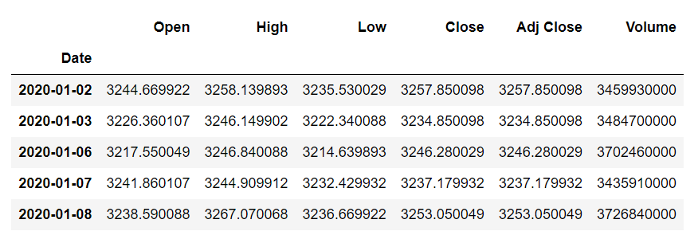
Dataset : S&P500
Glimpse of the data :

Slide 5
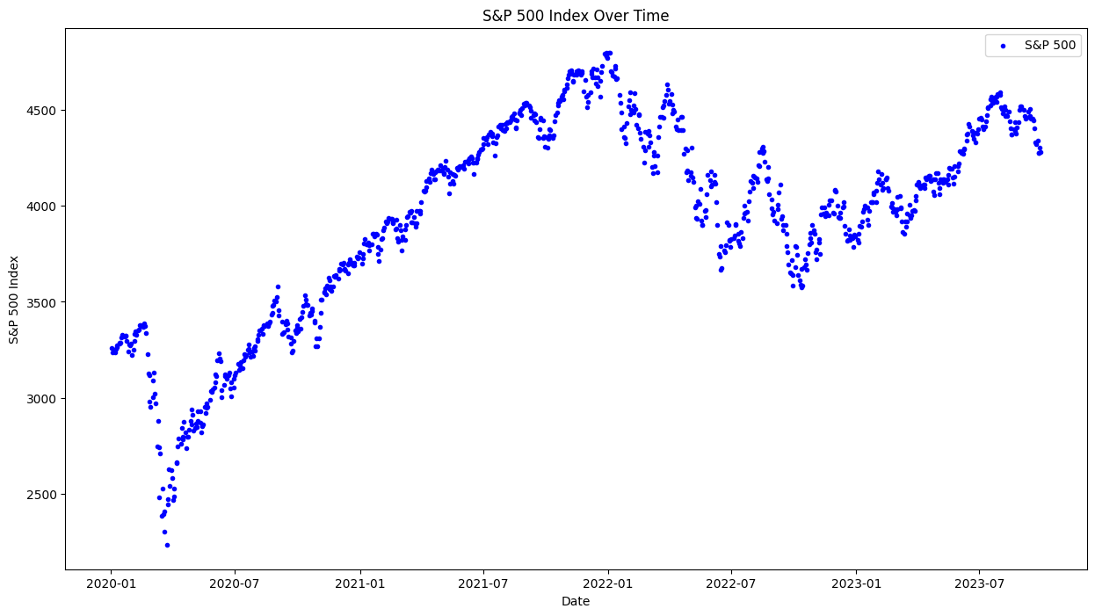

Slide 6
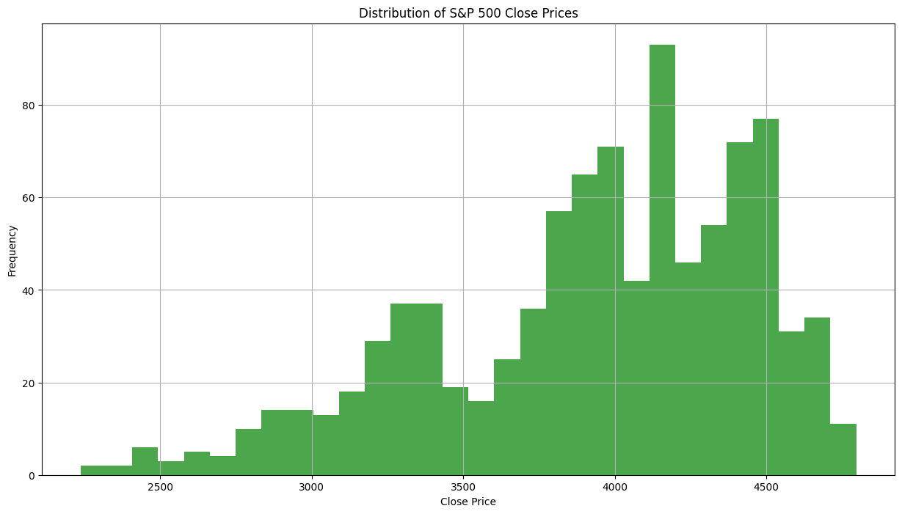

Slide 7
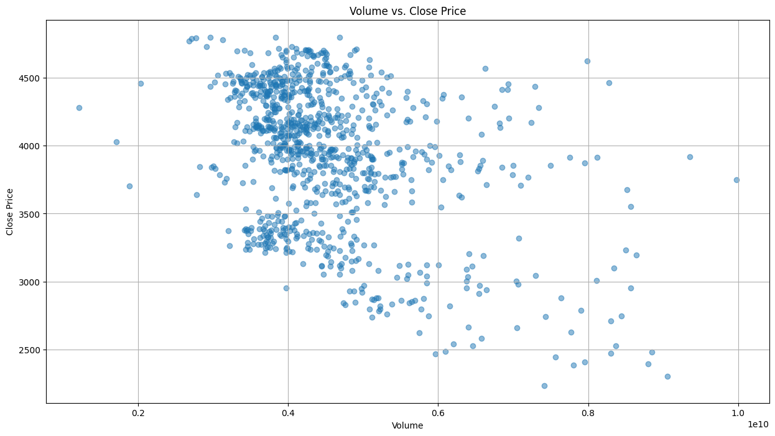

Slide 8

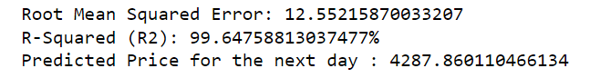
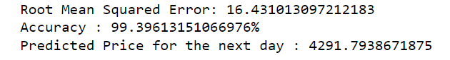
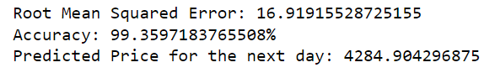
Regression Models :
Linear Regression
Evaluation and Optimization for Regression Model (Example: Linear Regression)
Random Forest
XGBoost

Slide 9
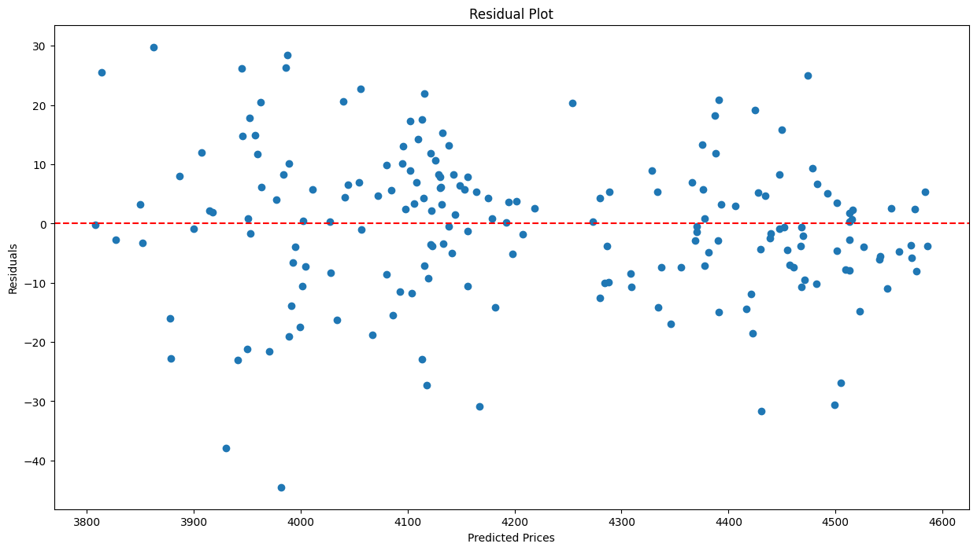

Slide 10
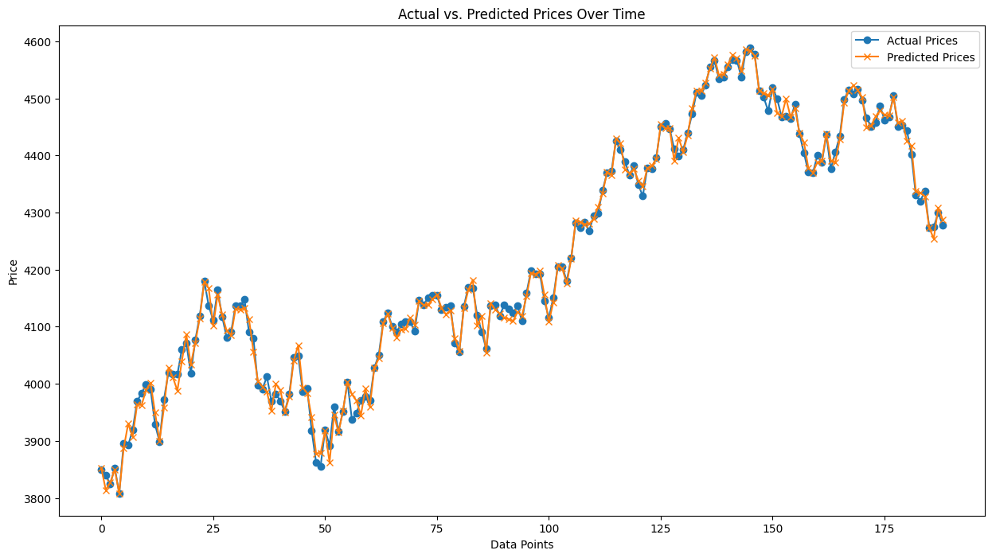

Slide 11
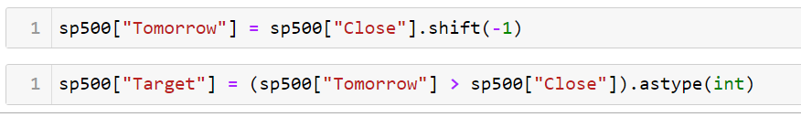
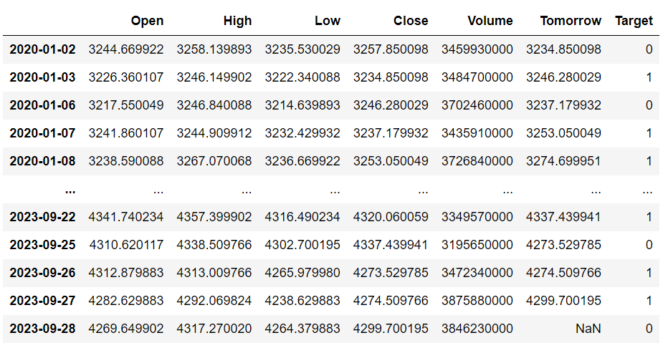
Classification Models :
Creating the target variable for classification

Slide 12
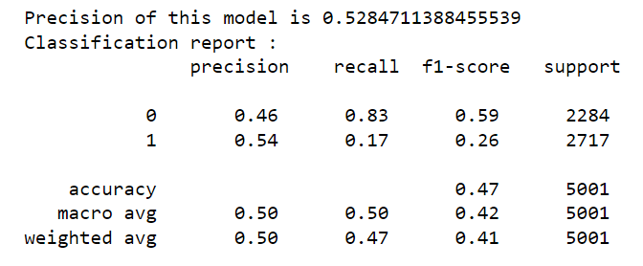
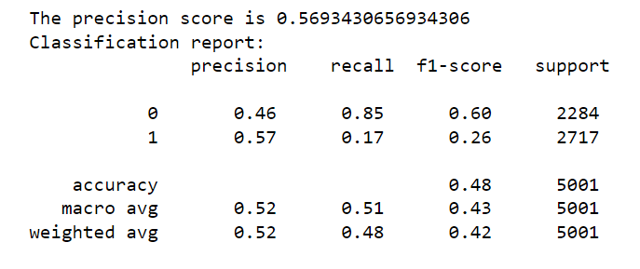
Classification Models :
Random Forest Classifier
Optimization of the classification model after using data mining techniques

Slide 13
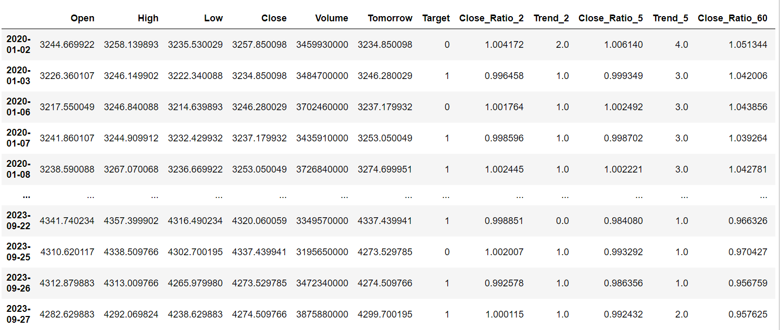
The columns added in the model to improve its precision score

Slide 14
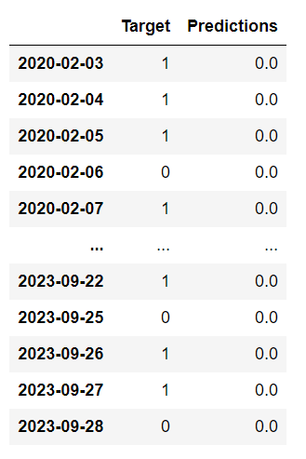
Predictions whether the stock will go up or down
The class labels for down is 0 and for up is 1

Slide 15
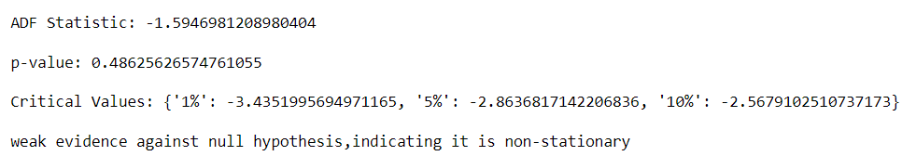
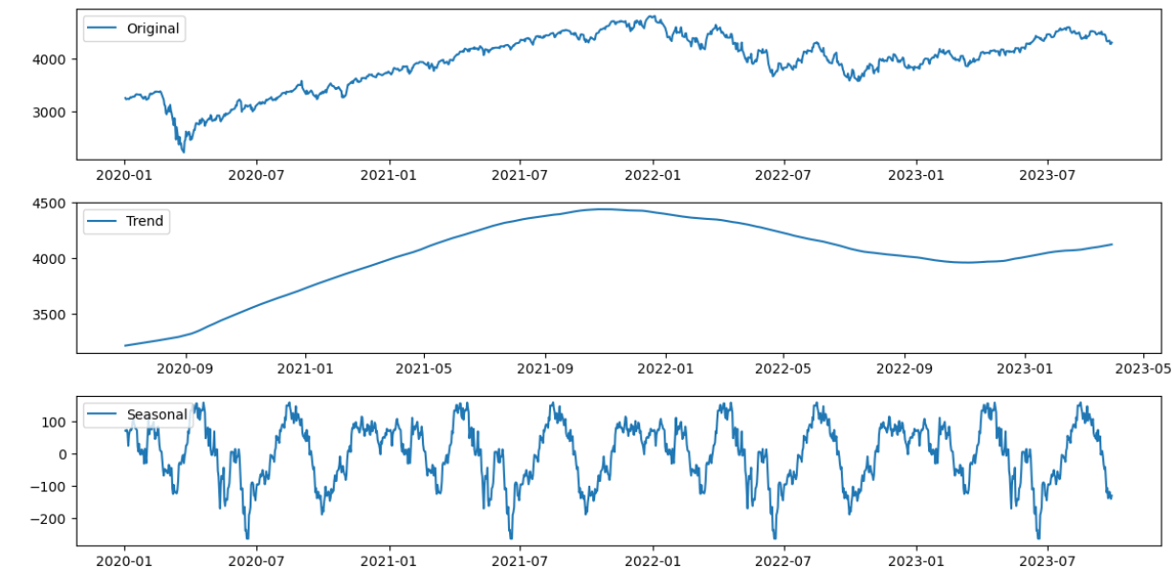
Time Series Model :
Checking stationarity
To make the series stationary we can apply a layer of differencing
Time series components of the data
We can see the presence of a clear seasonal pattern and a fluctuating trend from the decomposition of the closing price time series data.

Slide 16
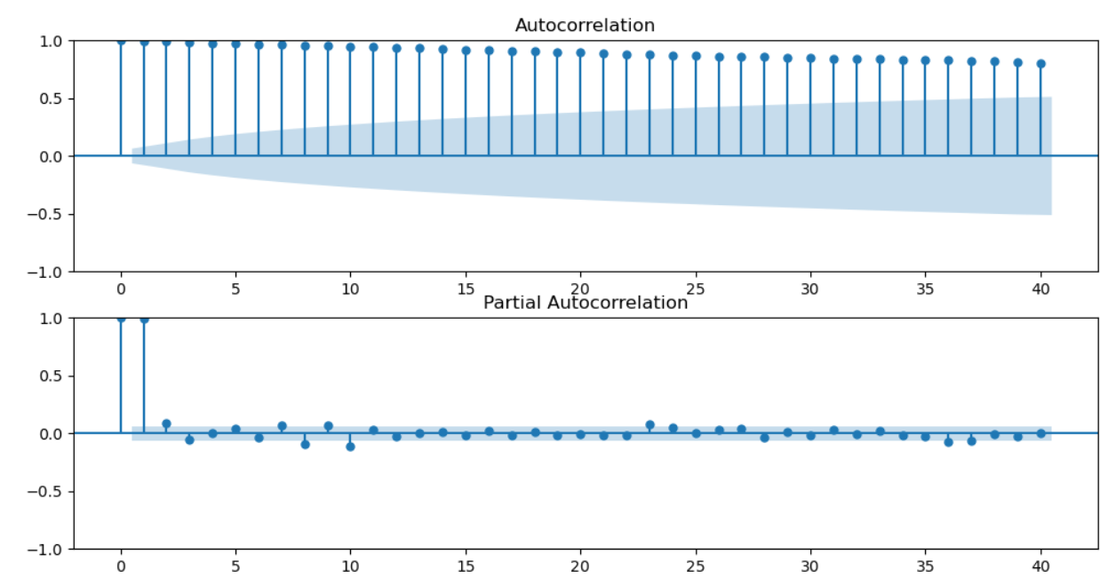
Autocorrelation and Partial Autocorrelation plots
By inferring the plots, we can judge the value of auto-regression (p) to be 1 and moving average (q) to be 1 as well.

Slide 17
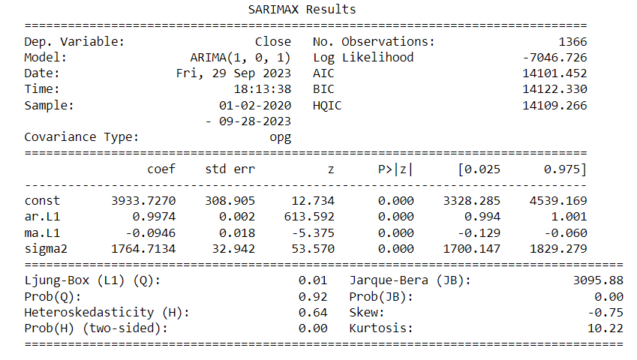
Summary report of the ARIMA(1, 0, 1) model
By inferring the summary results we can see that all components (constant, ar.L1, ma.L1, sigma2) are significant in our model hence they should be kept.

Slide 18
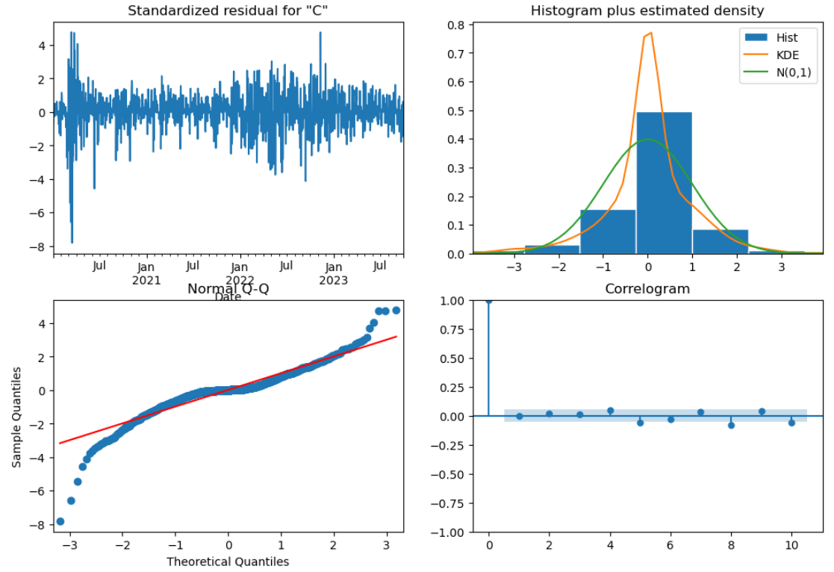
Diagnostic plots of the model
We can check the normality of the data using the plot diagnostics.

Slide 19
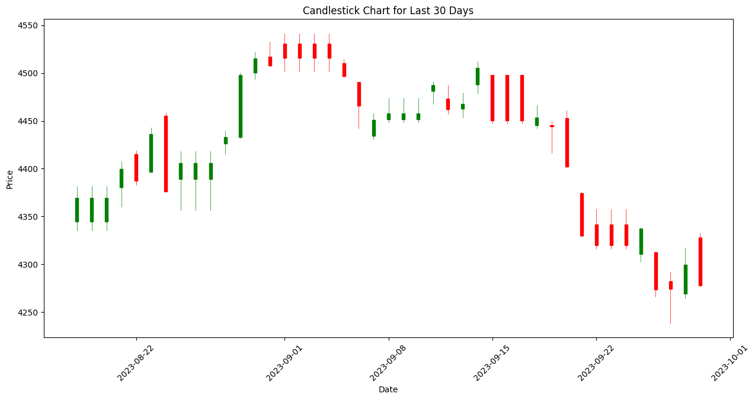

Slide 20
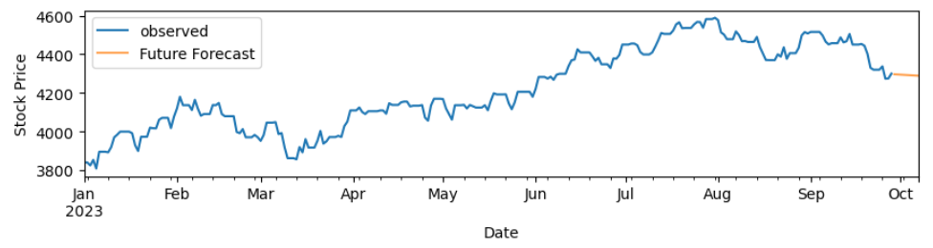
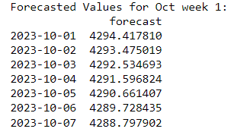
Future forecast of a week
Our model performance by MSE and RMSE

Slide 21

THANK YOU
ANY QUESTIONS ?

